Slide 1

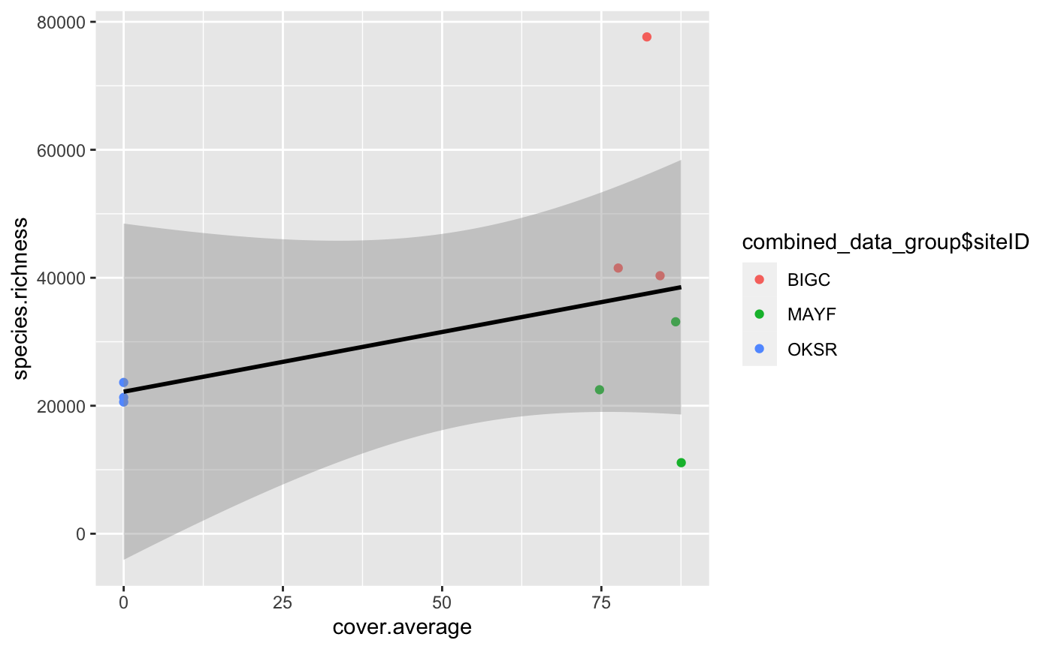

Riparian Buffer Percent Coverage Effect On Aquatic Macroinvertebrates Richness
Chelsey Burks, Jonathan Ray, Callie Wallace
Introduction/Background
Figure 1
Results
Research Question & Hypothesis/Prediction
Figure 2
Discussion
Methods
Table with Caption or Picture or Figure
Next Steps/Future Directions
References & Acknowledgements

